Slide 1
SAR - ADC
Yi Tong

Slide 2
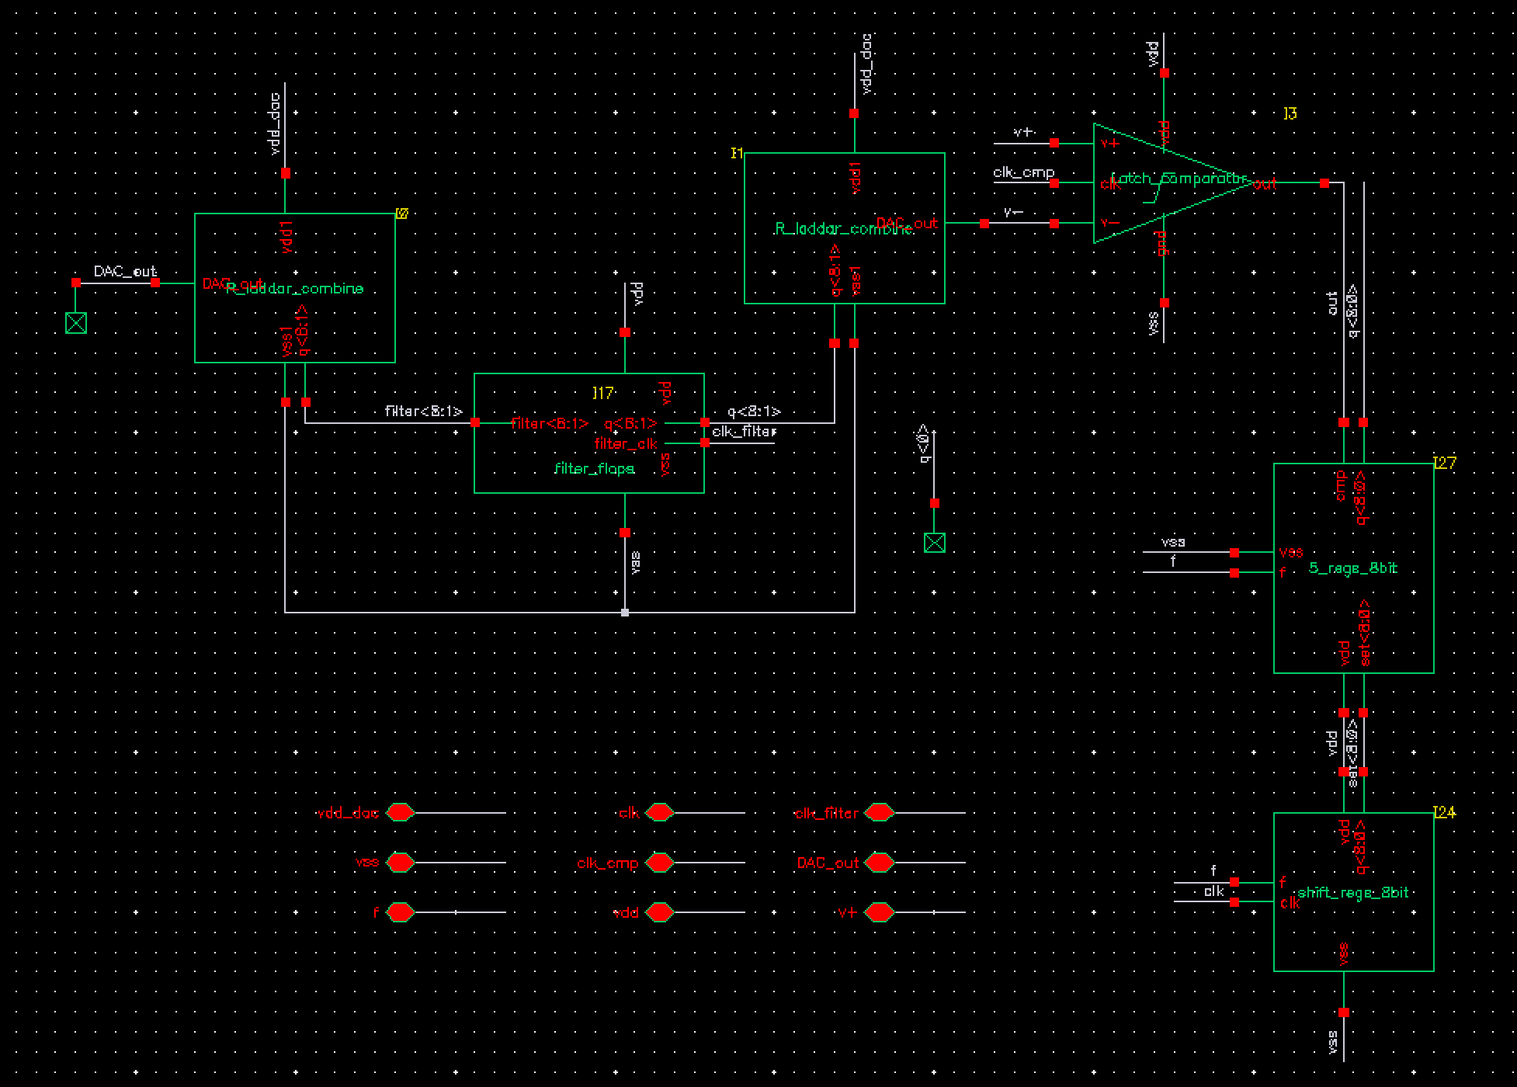
Schematic
DAC
Comparator
DAC
Filter_regs
DAC
Keeper (SAR)
Step Mover

Slide 3
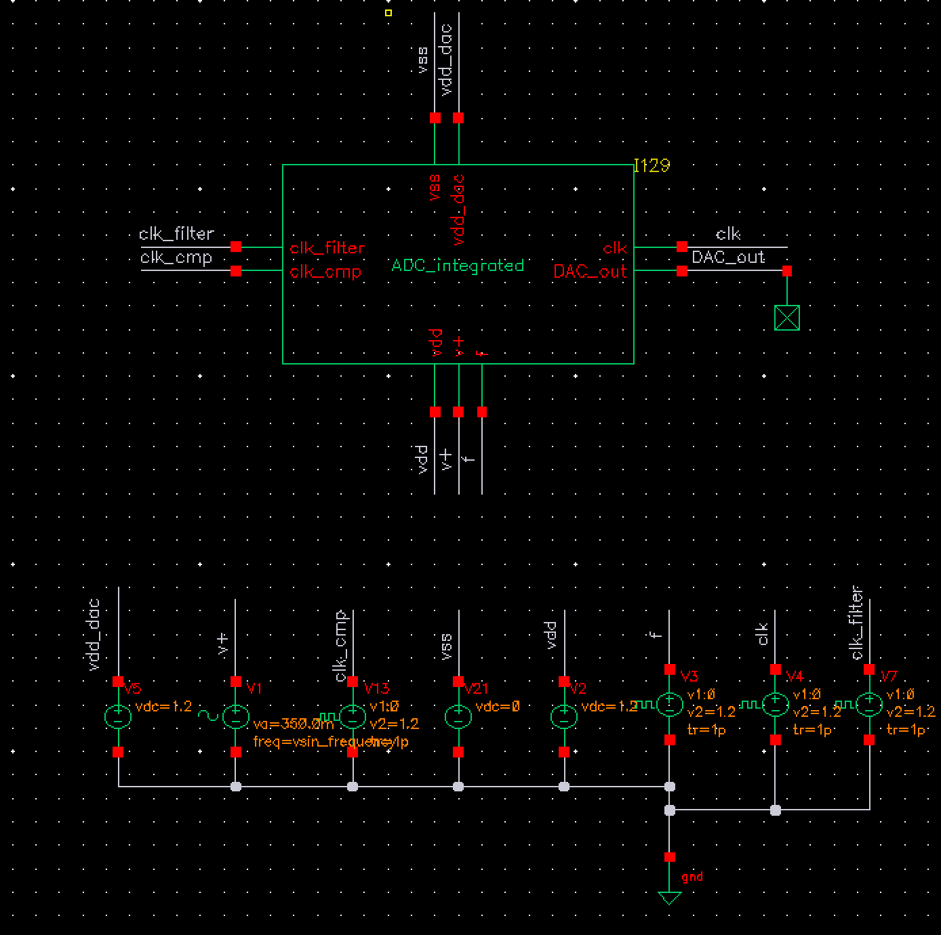
Top view

Slide 4
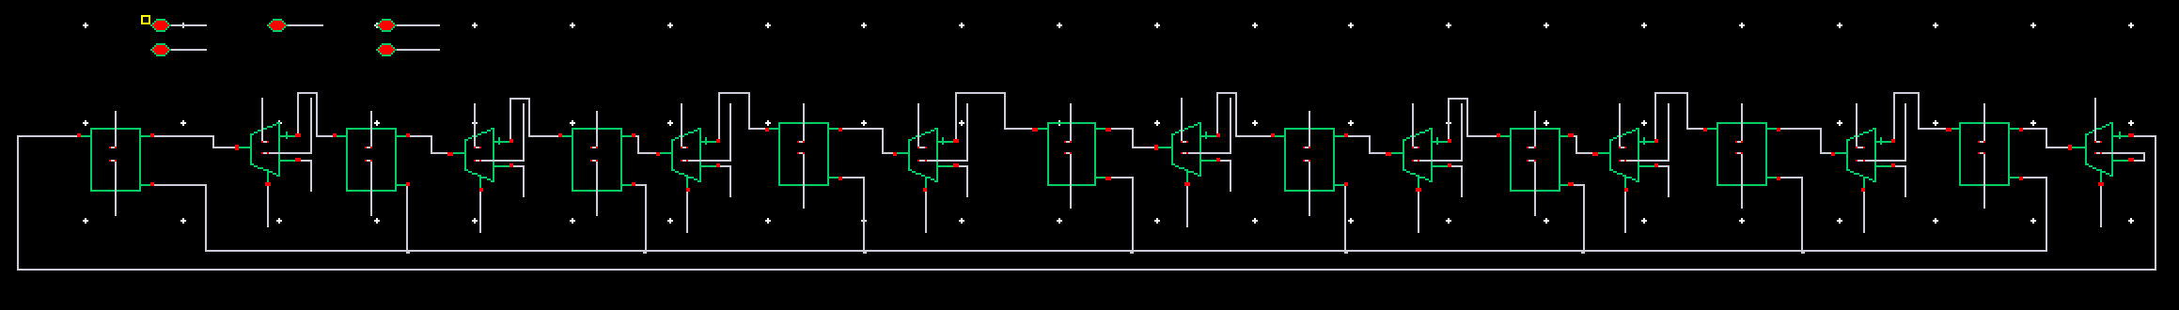
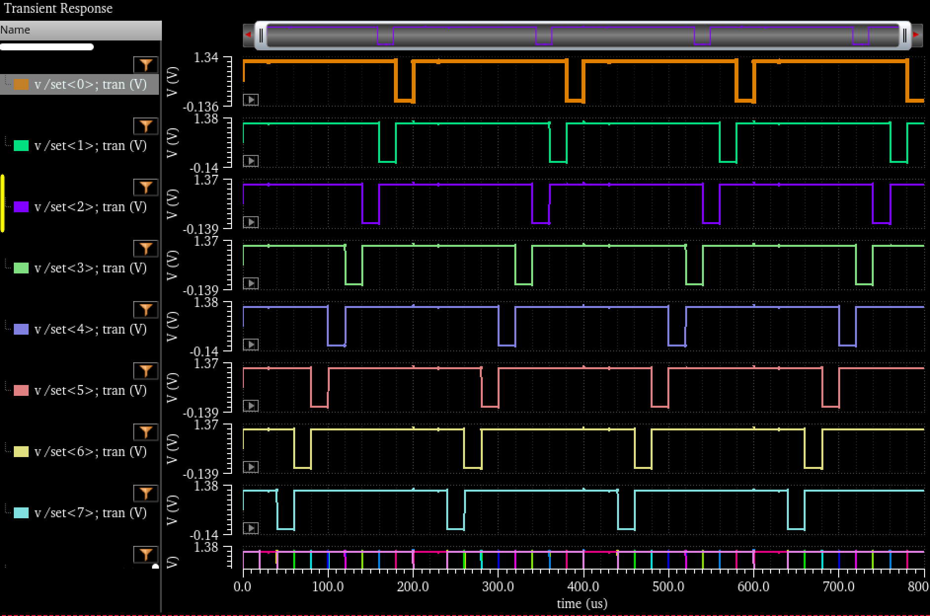
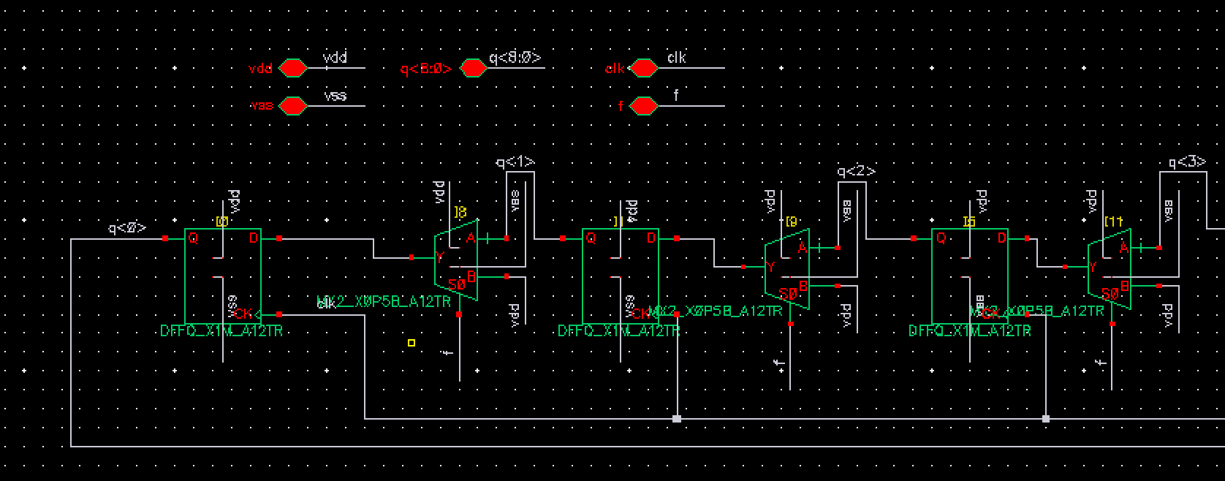
Set Mover- schematic

Slide 5
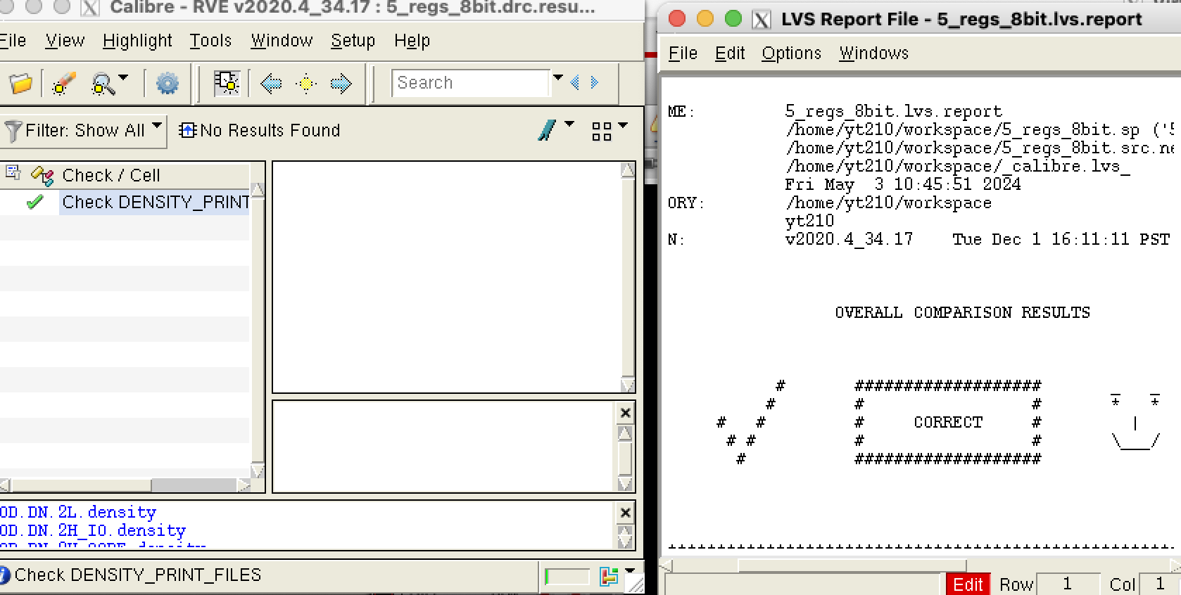
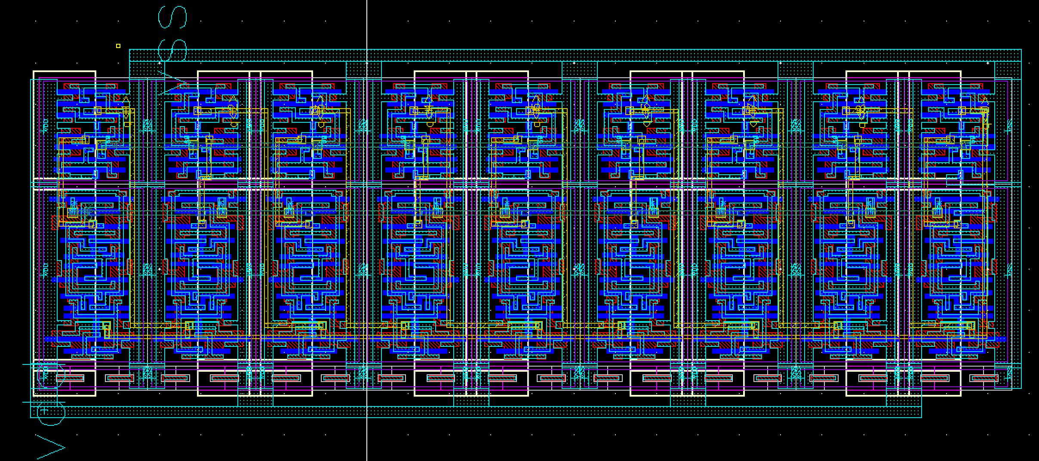
Set Mover - Layout

Slide 6
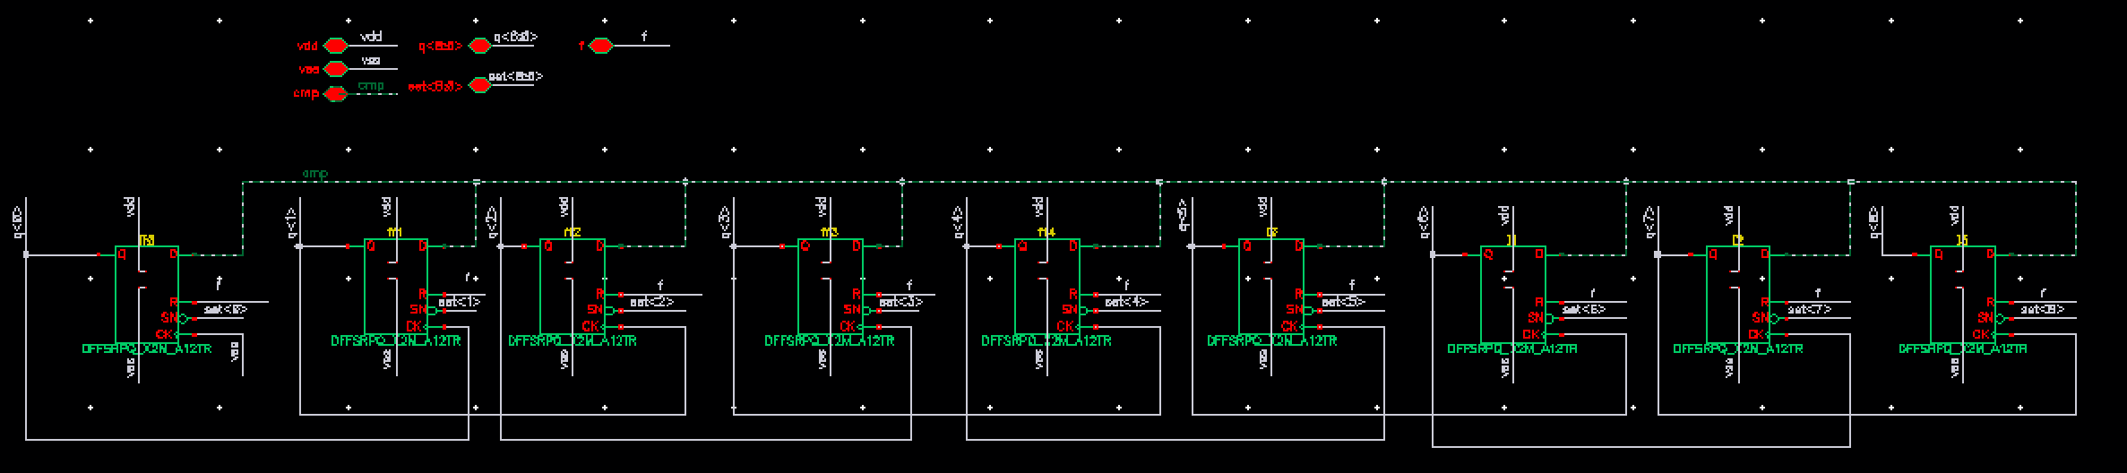
Keeper (SAR Logic)
Full Schematic

Slide 7
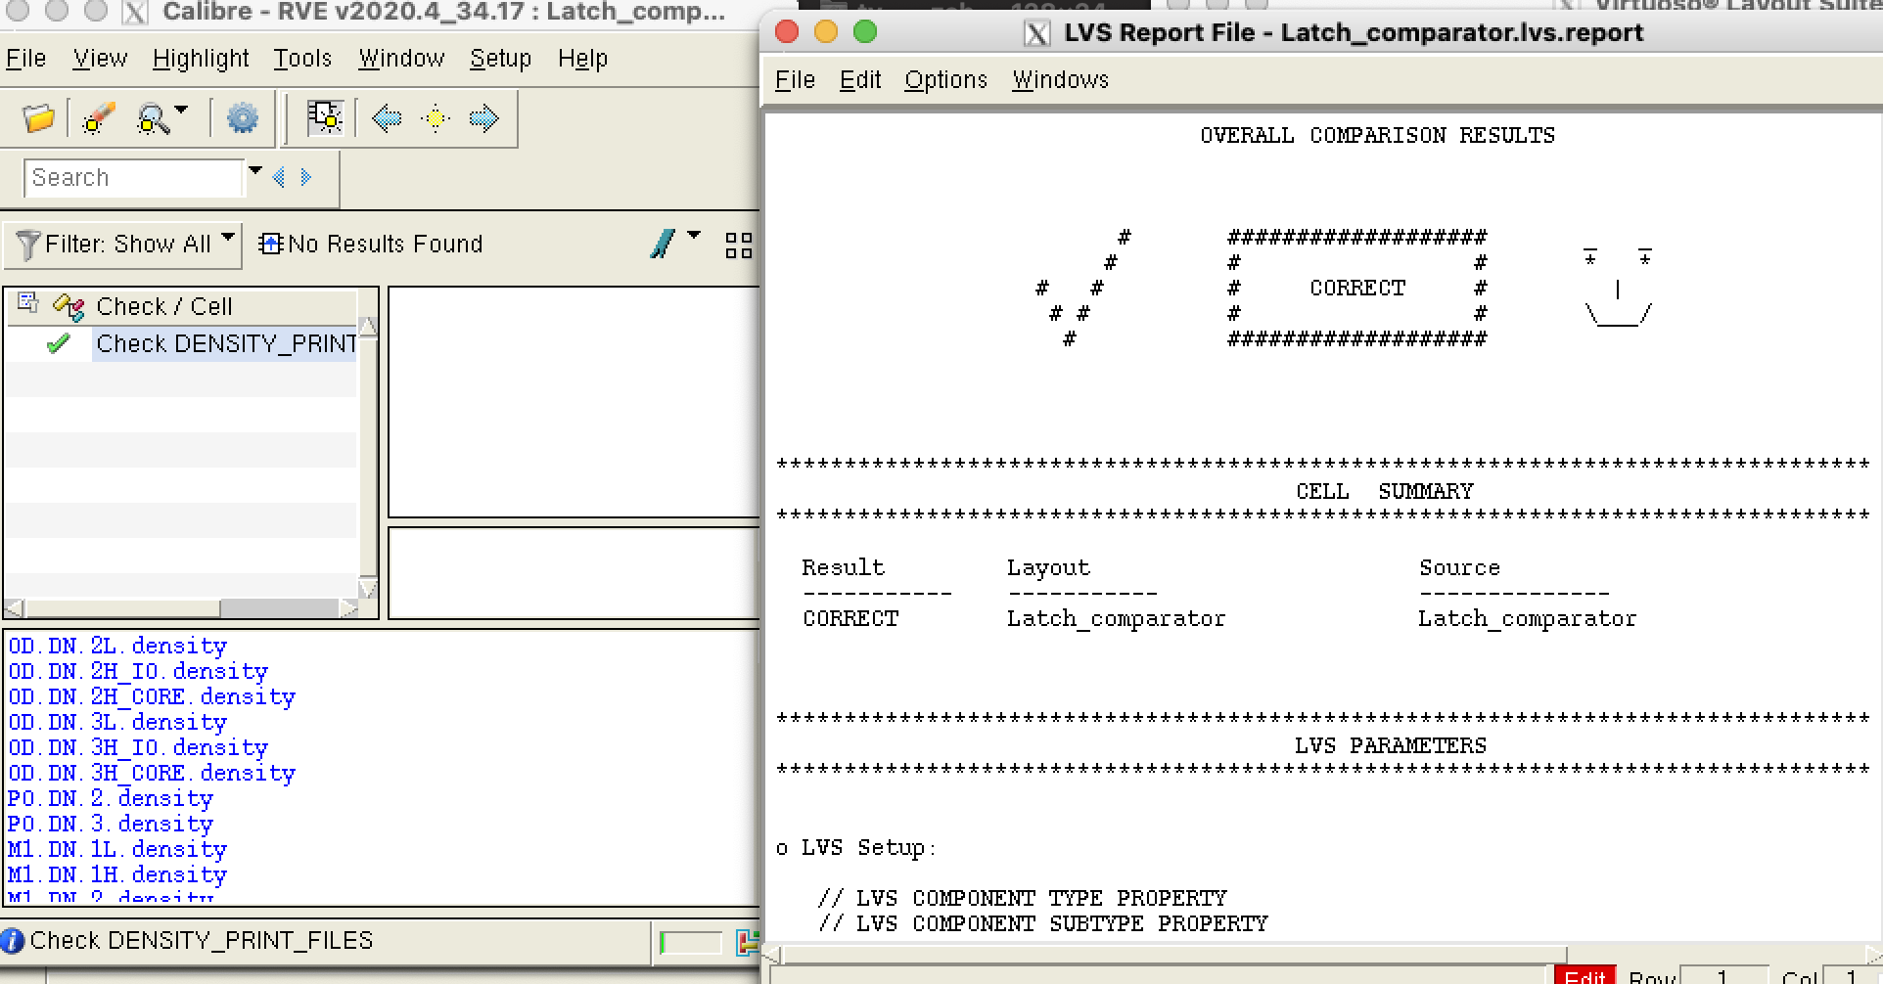
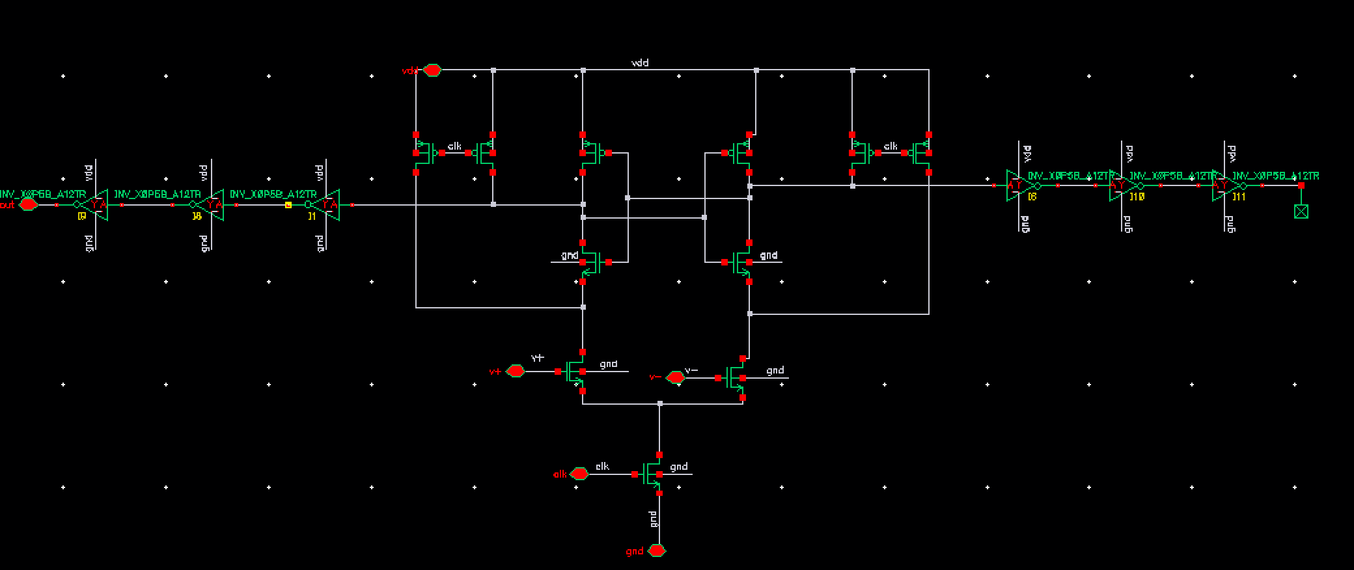
Comparator - schematic
Full Schematic

Slide 8
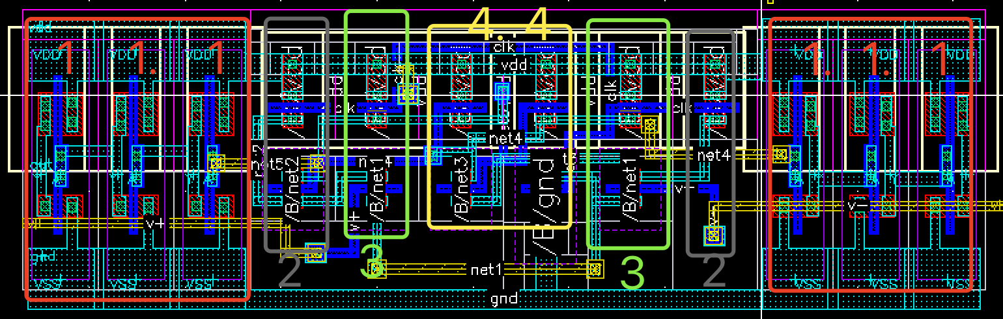
Comparator – layout

Slide 9
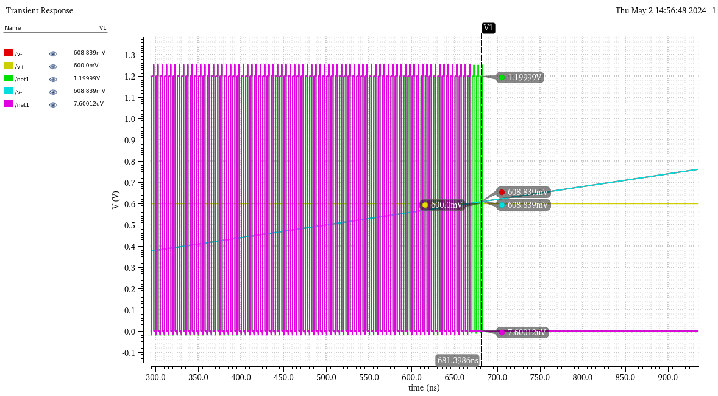
Comparator – simulation (pre&post)
Post layout
Pre layout
Resolution: 8 mV
Tr < 1 ns

Slide 10
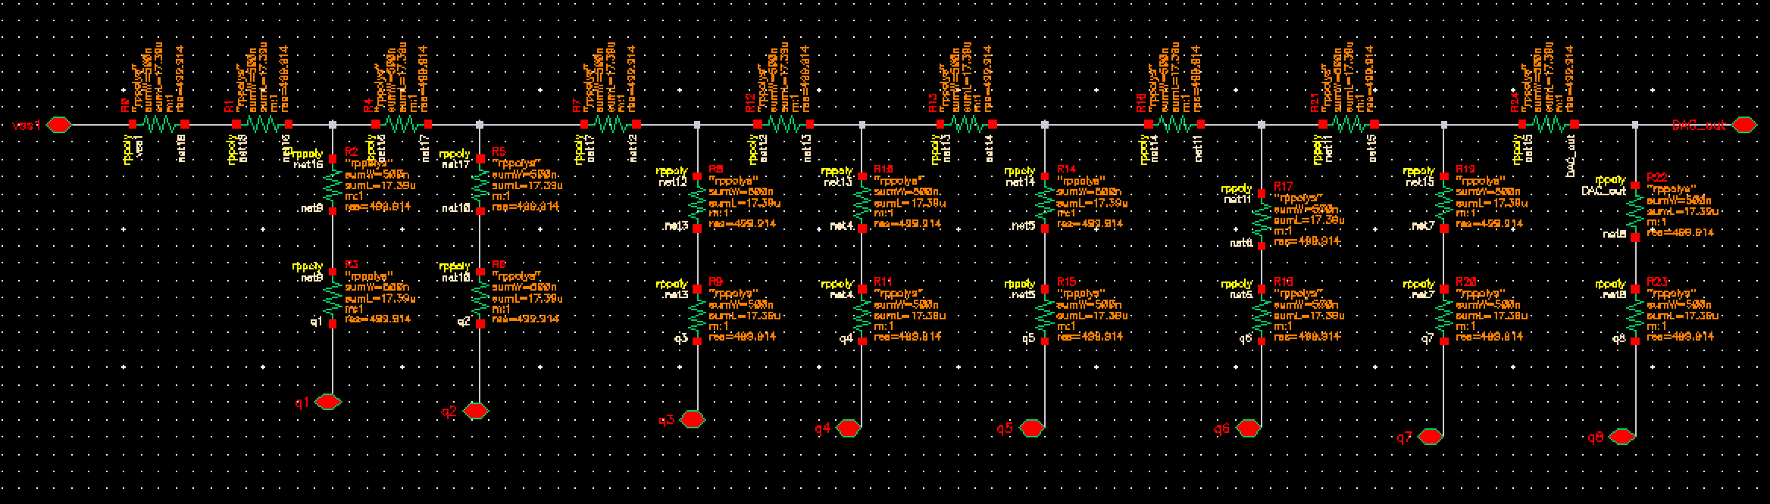
DAC-R 2R Laddar （Resistor tree）

Slide 11
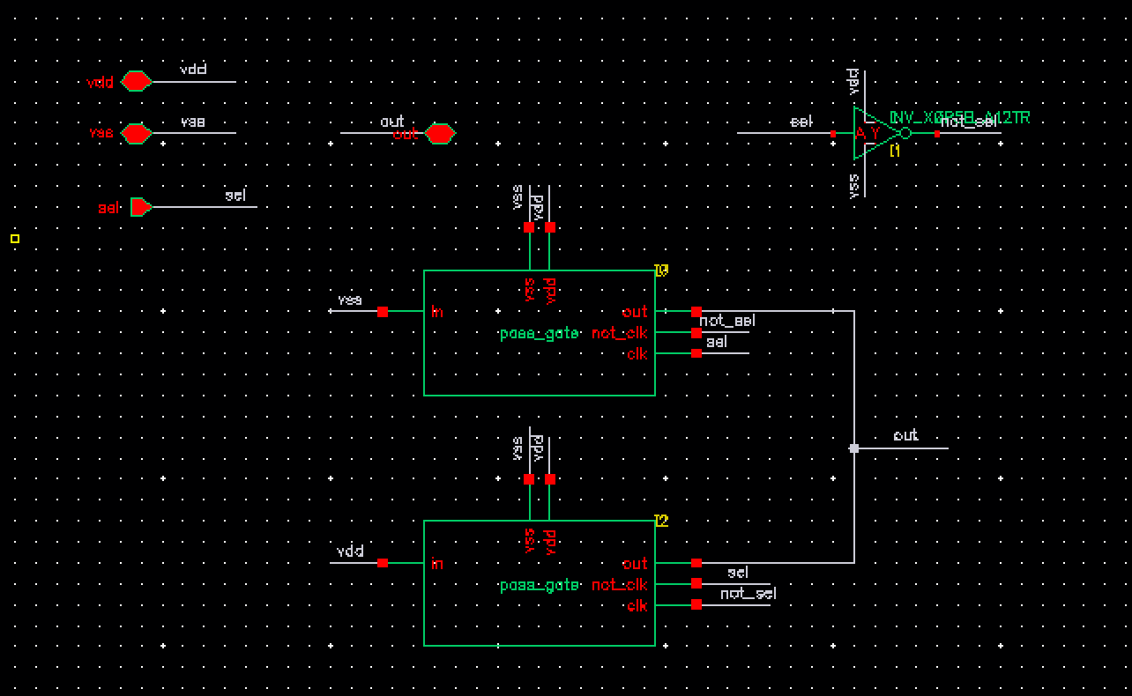
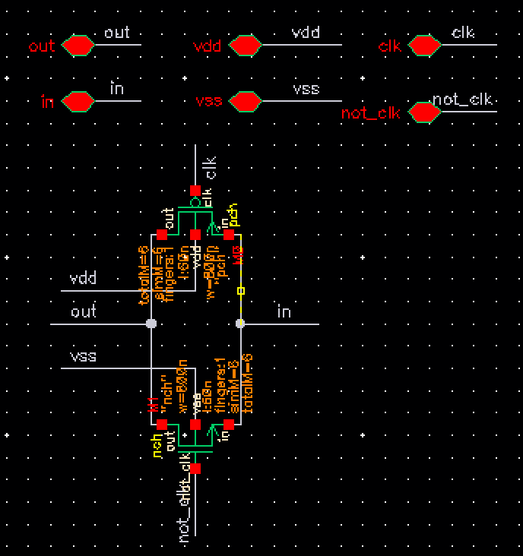
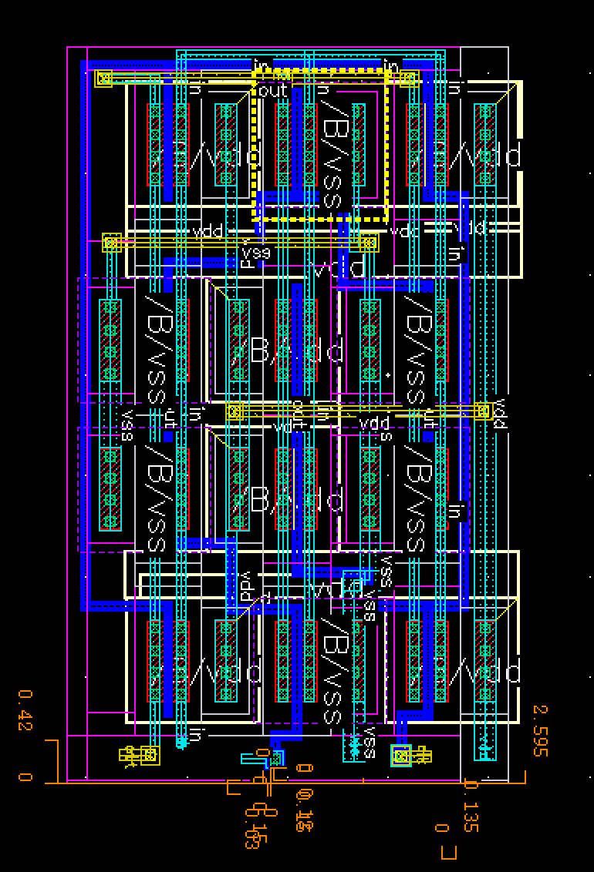
DAC-R 2R Laddar （Switches）
T_gate size: w = 5u, l = 60n
Inverter: library

Slide 12
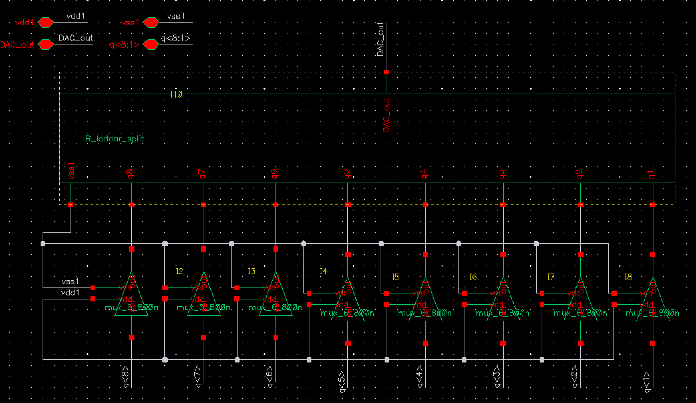
DAC-R2R Laddar (whole)

Slide 13
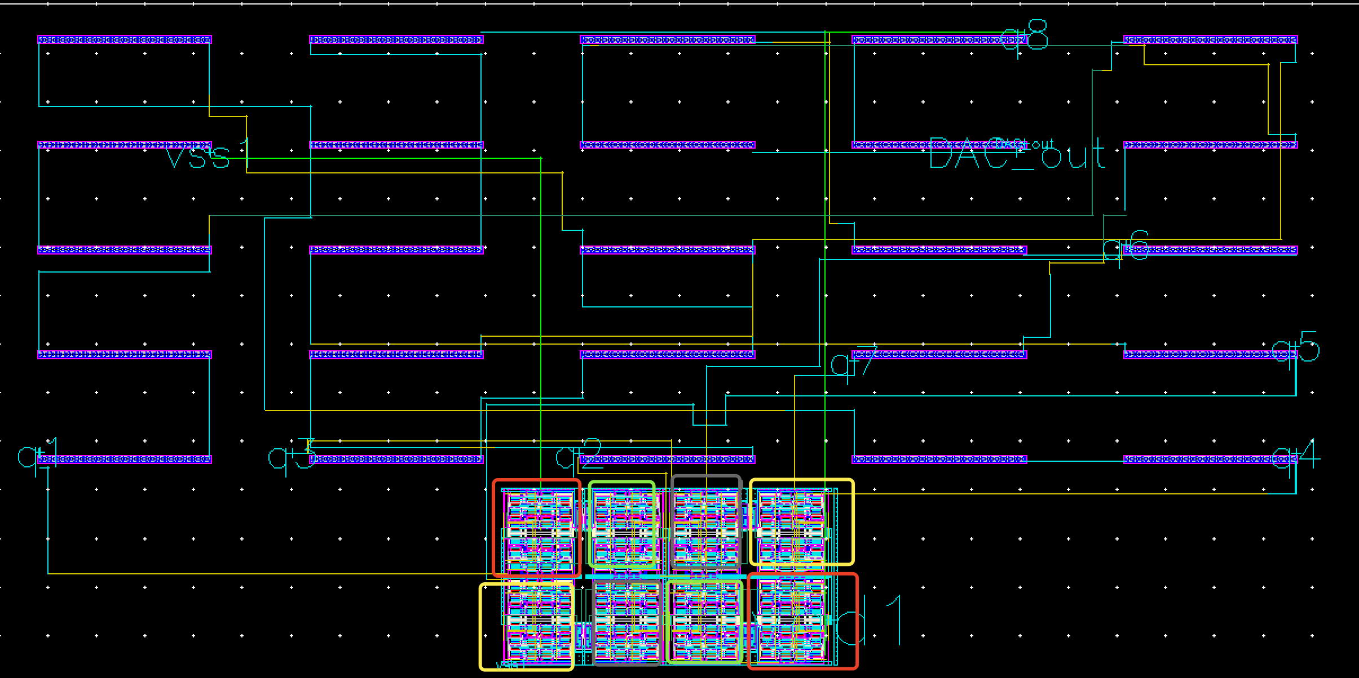
DAC-R2R Laddar

Slide 14
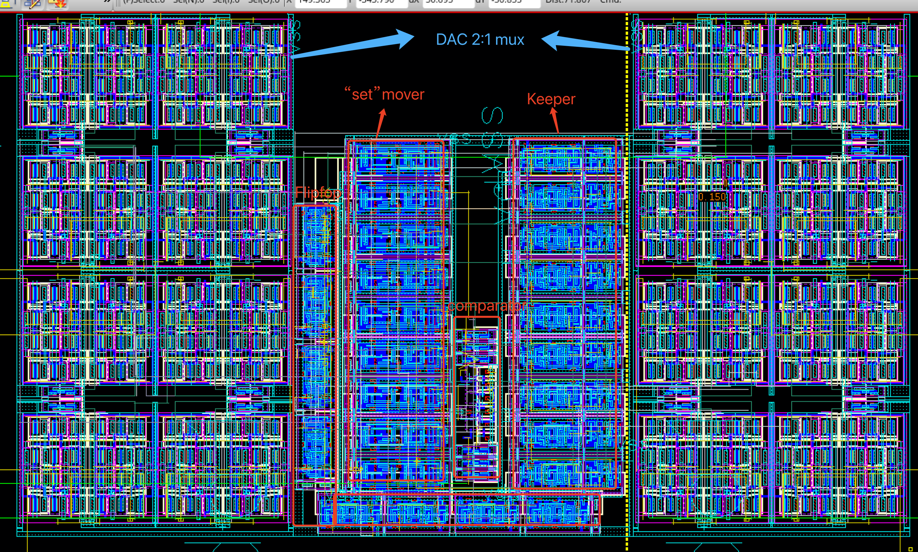
Layout (except rpoly)

Slide 15
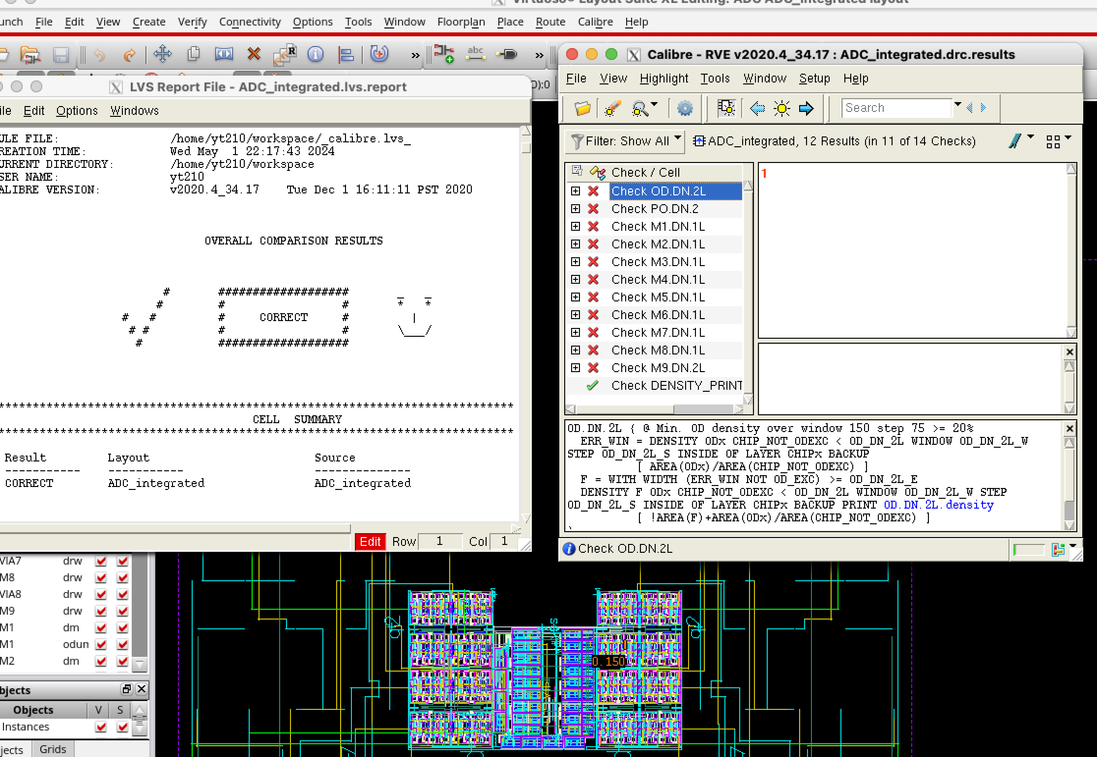
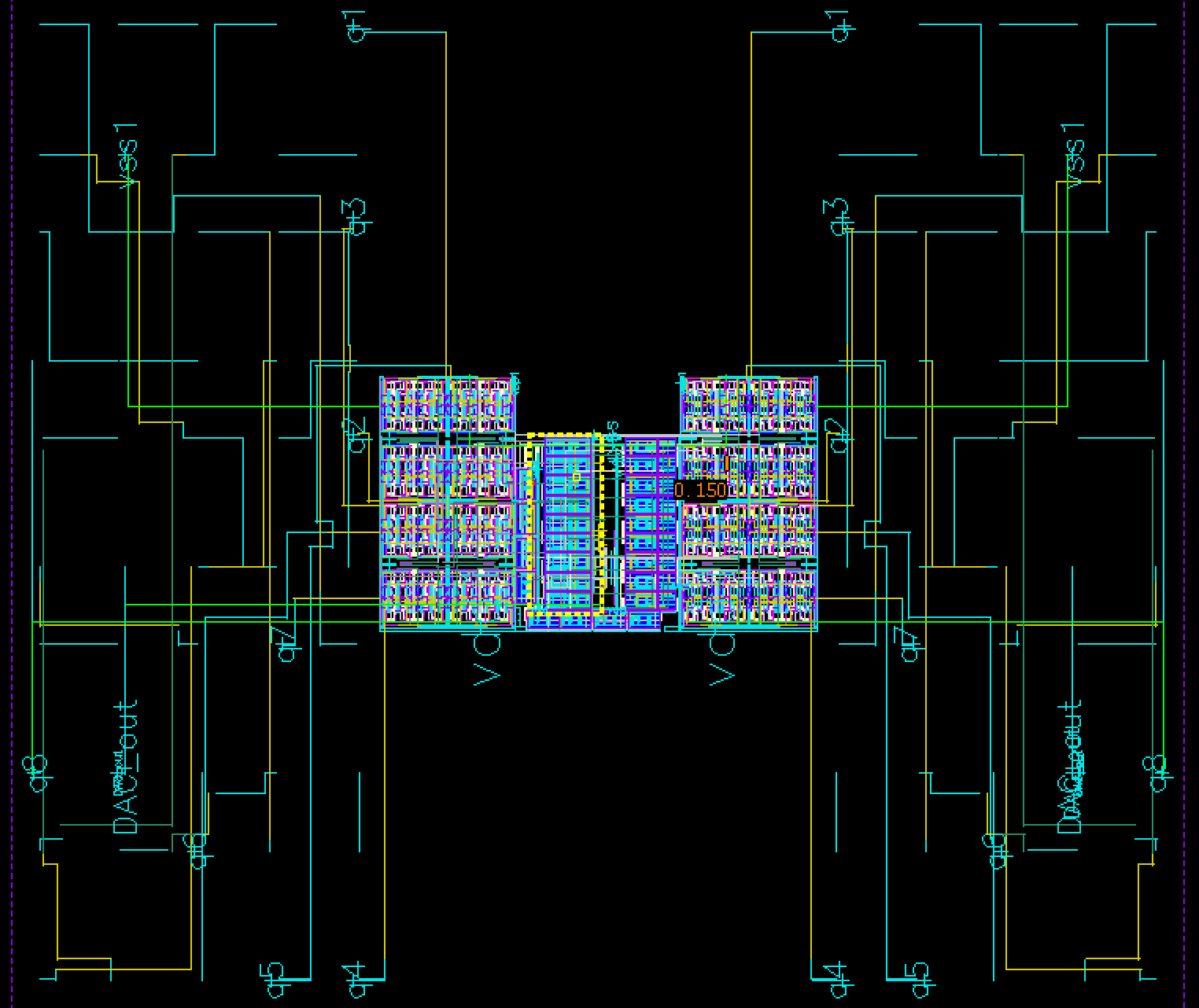
Full Layout
- All clean

Slide 16
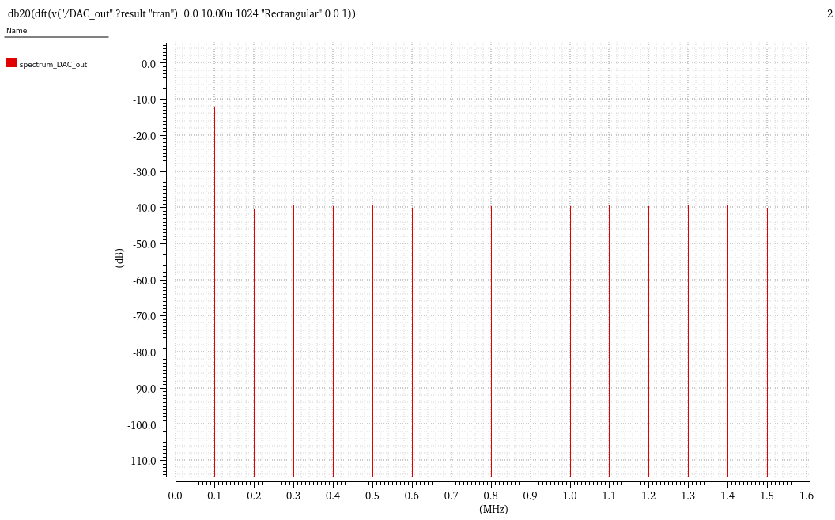
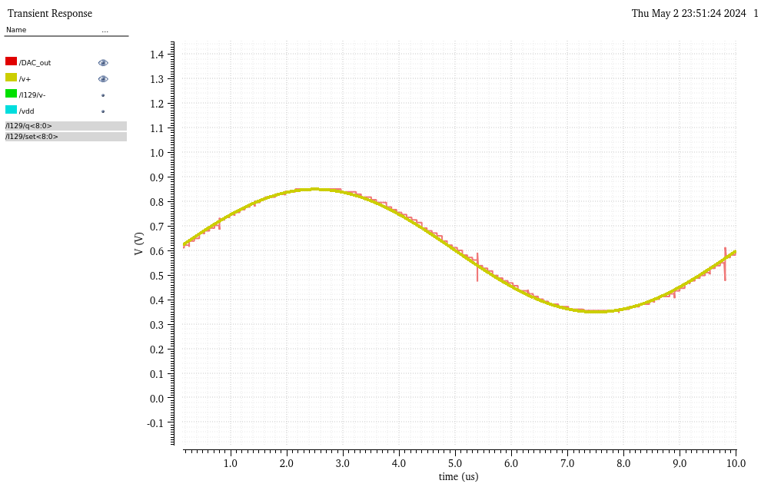
SAR Extracted result – 100K Hz
30 dB

Slide 17
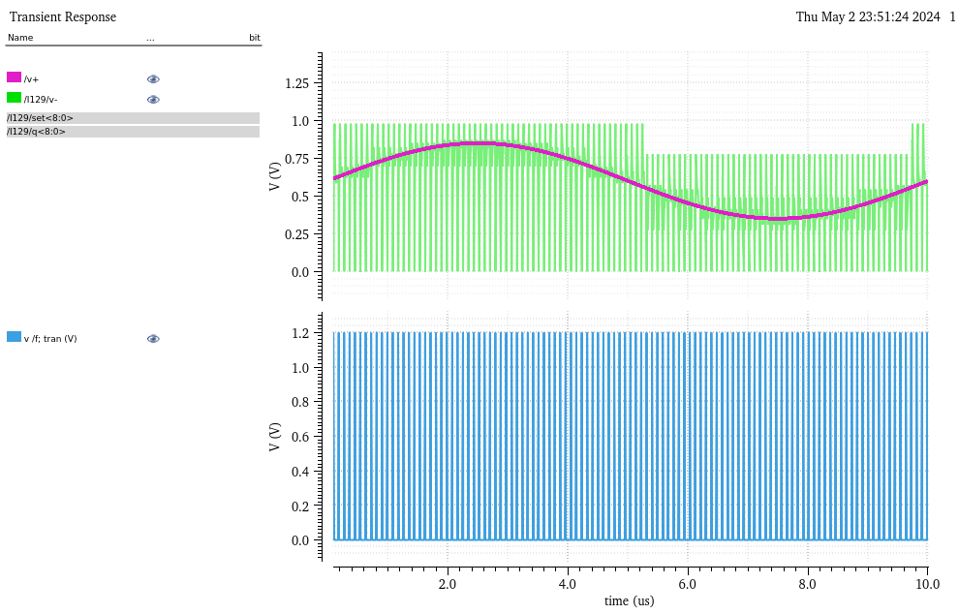
SAR result

Slide 18
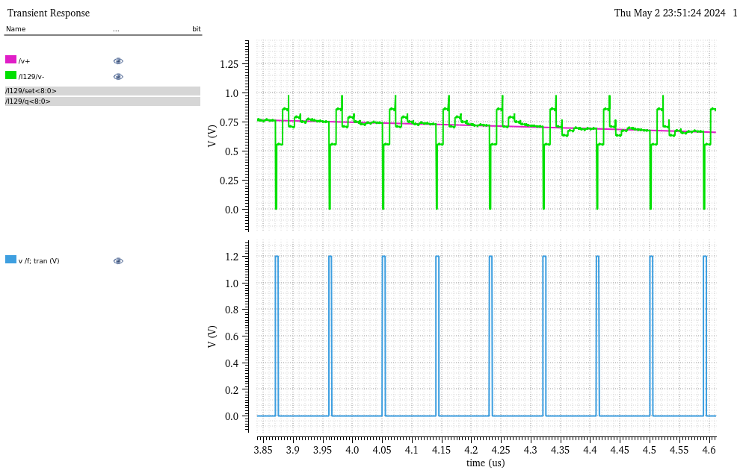
SAR result

Slide 19
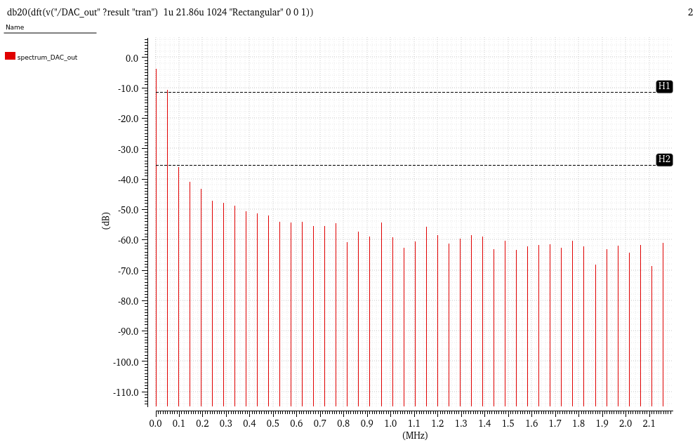
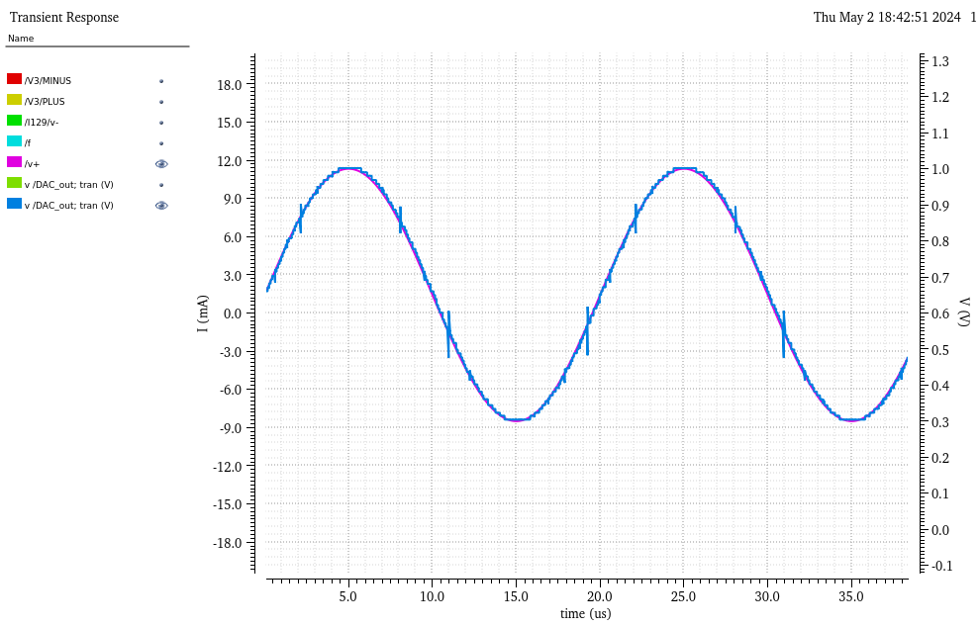
Simulation – 50K Hz

Slide 20
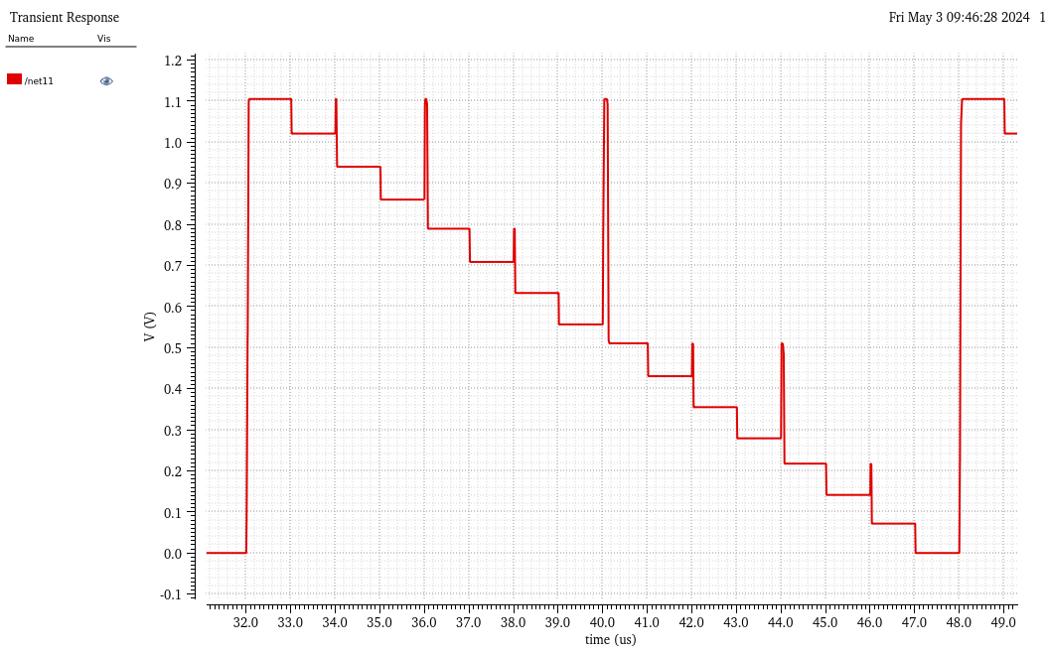
Defects:

Slide 21
SAR Extracted result – 100K Hz
30 dB

Slide 22
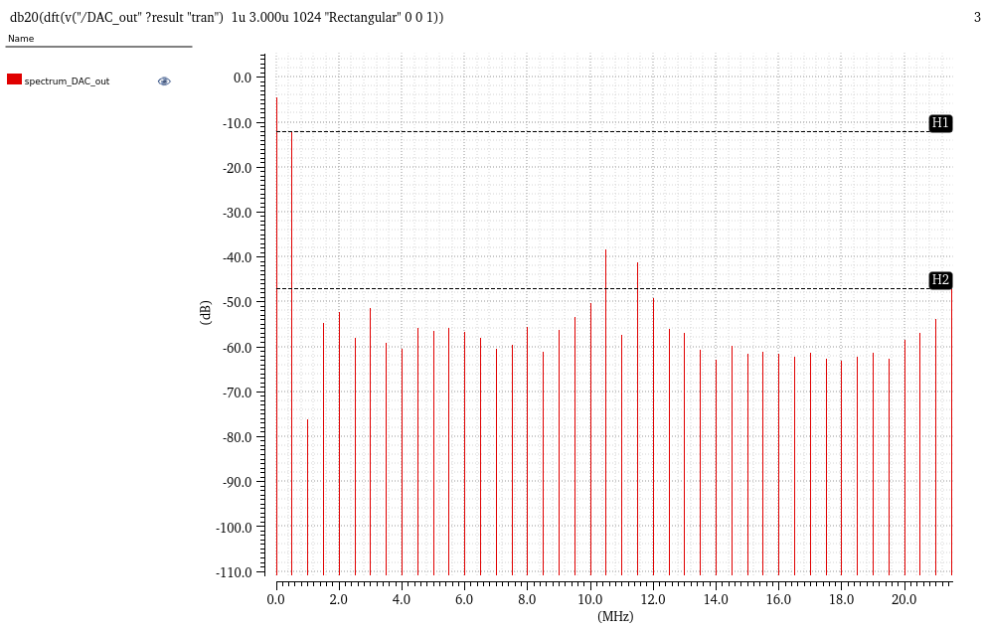
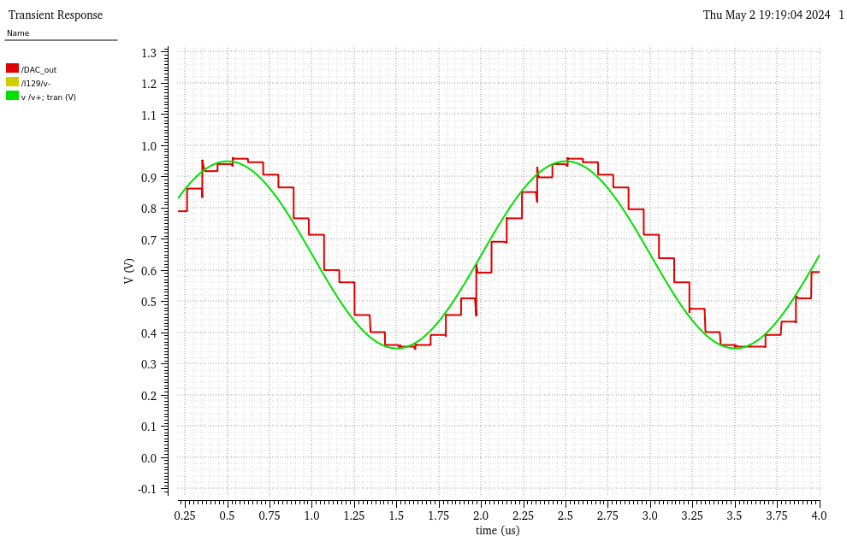
Simulation – 500K Hz
0 0.5M

Slide 23
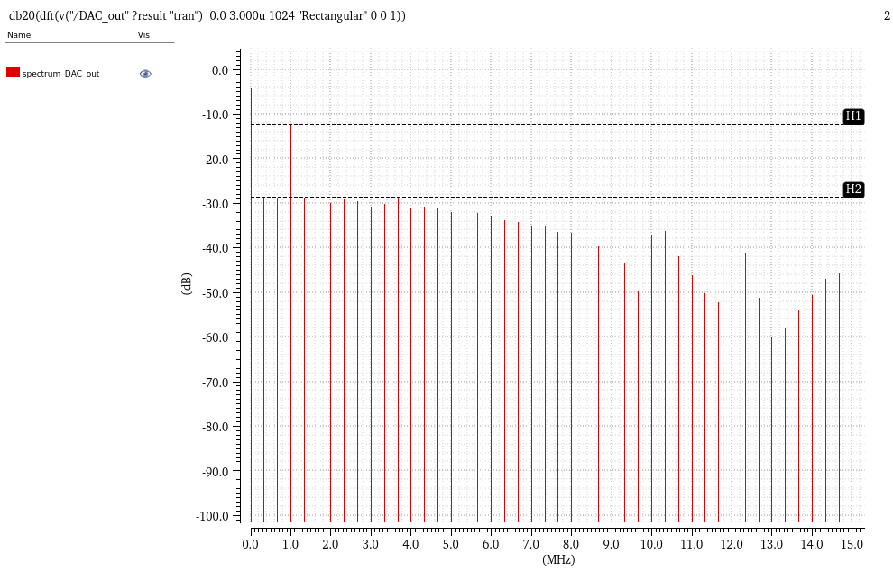
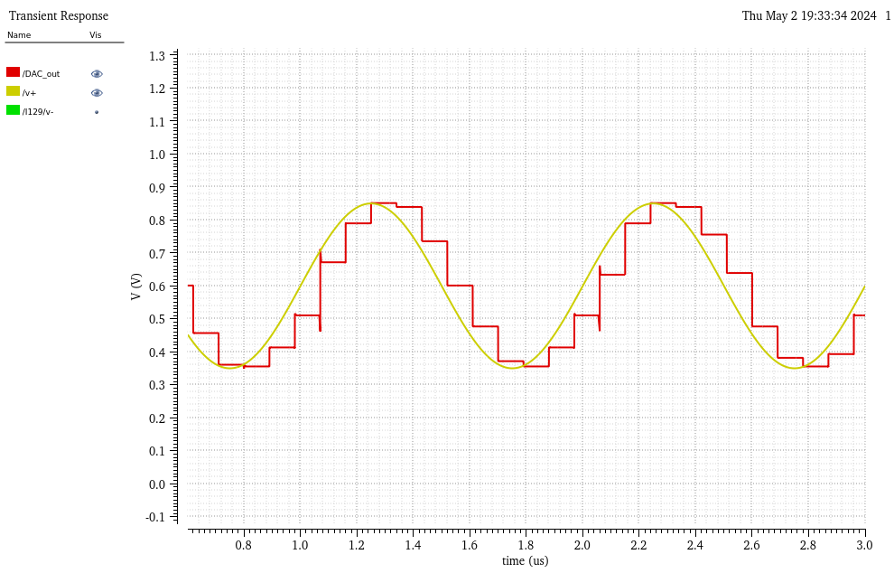
Simulation – 1M Hz

Slide 24
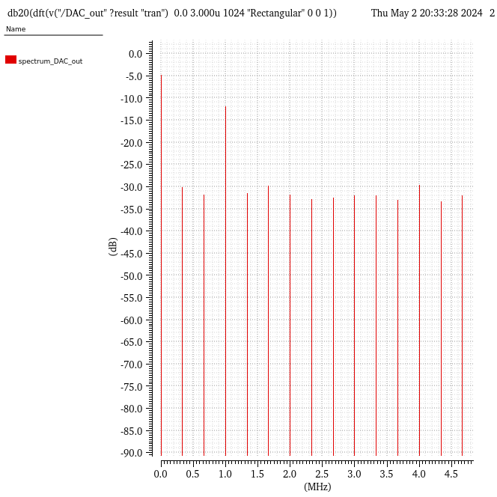
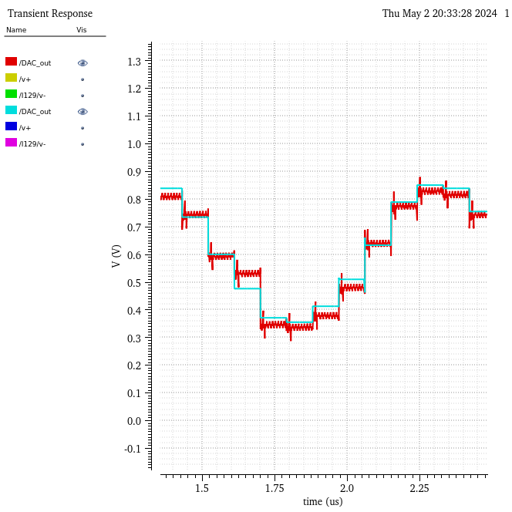
Simulation – 1M Hz, Pre&post layout
Pre Layout
Post Layout

Slide 25
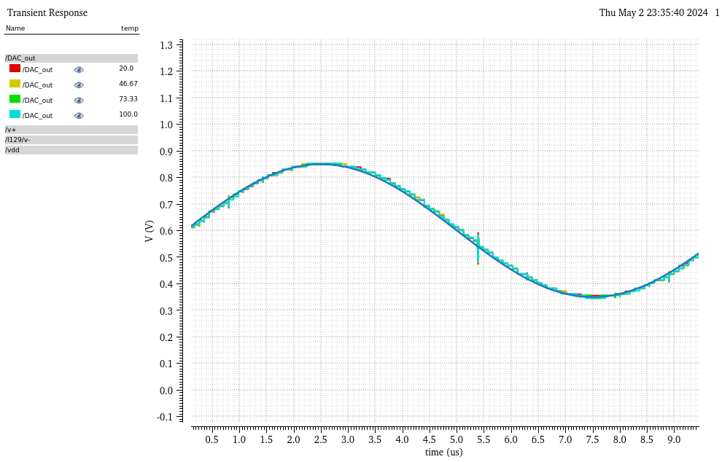
Temp drifting

Slide 26
Specs
Area: 55x34 – 22.45x8.38 = 1681 um² Total inst: 1338
Resolution: 8 Bits
Range: 0.25V ~ 1.2 V Sampling frequency: 10 MHz

